Slide 1

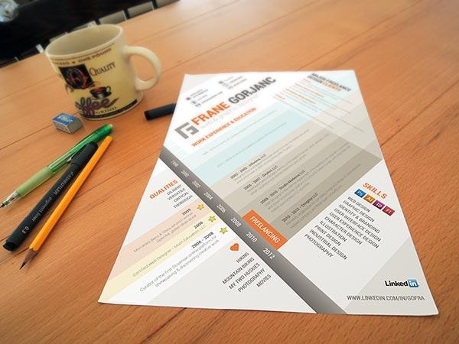
Developing Your CV Professional Development
Notes:
Leadership requires you to be willing to stand out! Switch off your cams… get on the internet and search for a quote on leadership and read it out to everyone in the class!

Slide 2
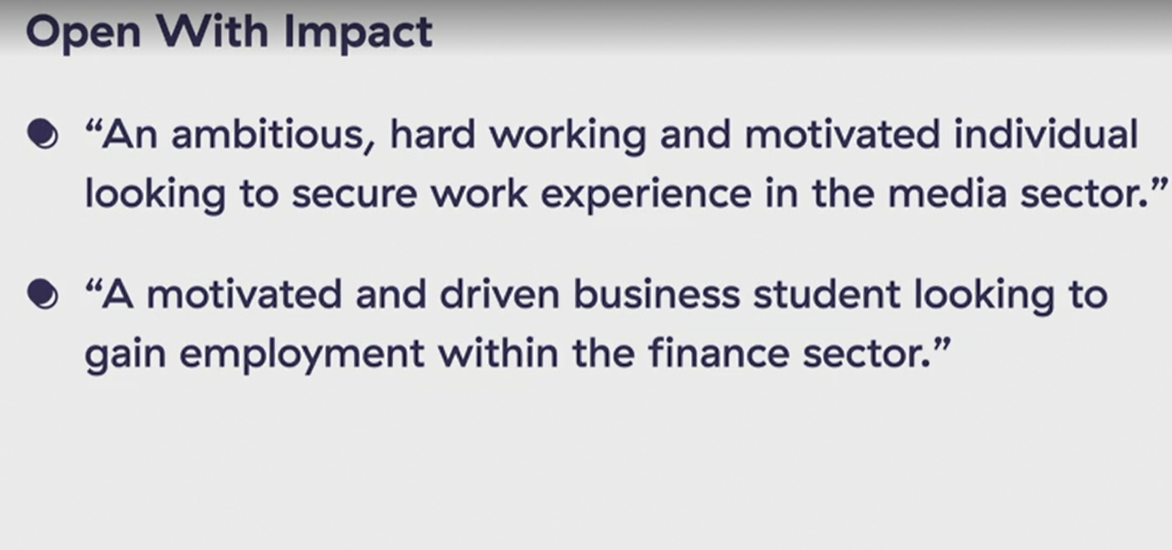

Slide 3
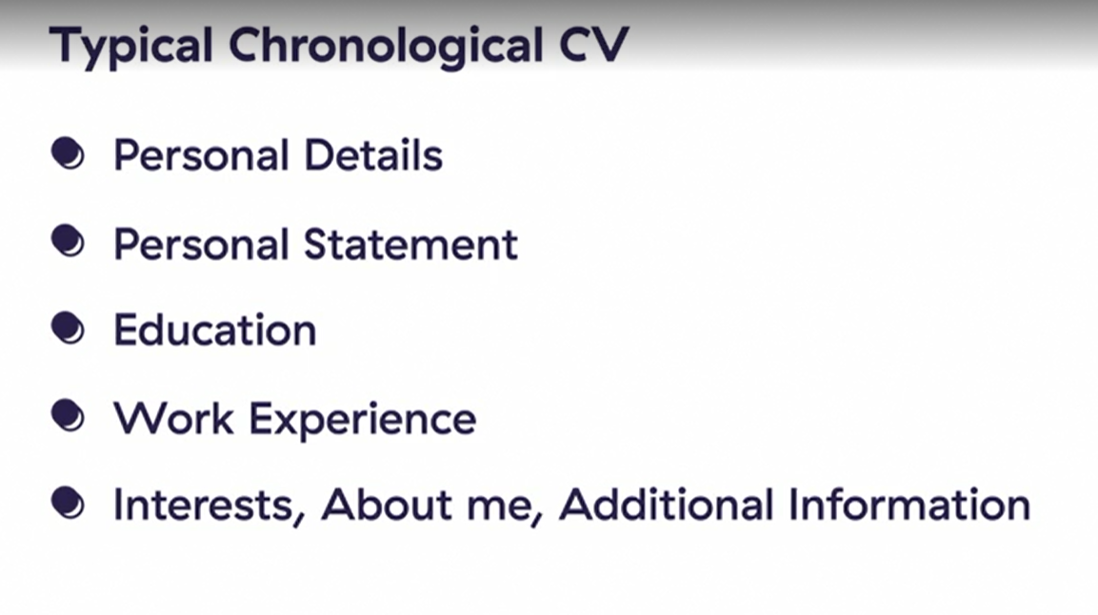

Slide 4
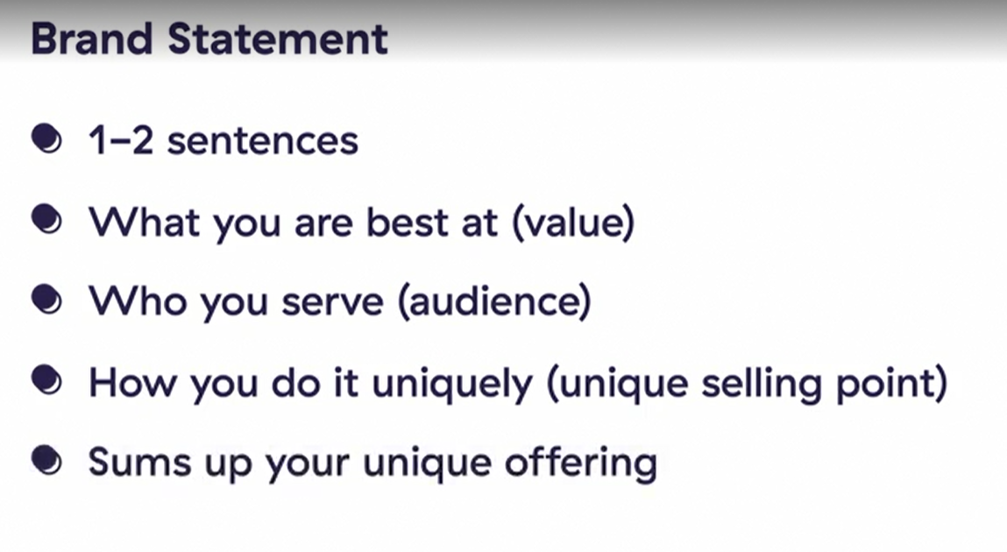

Slide 5
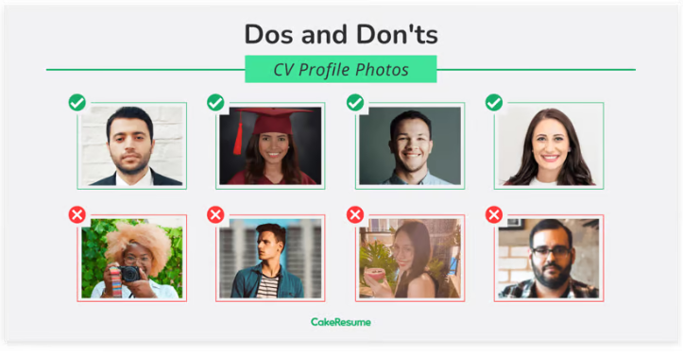

Slide 6
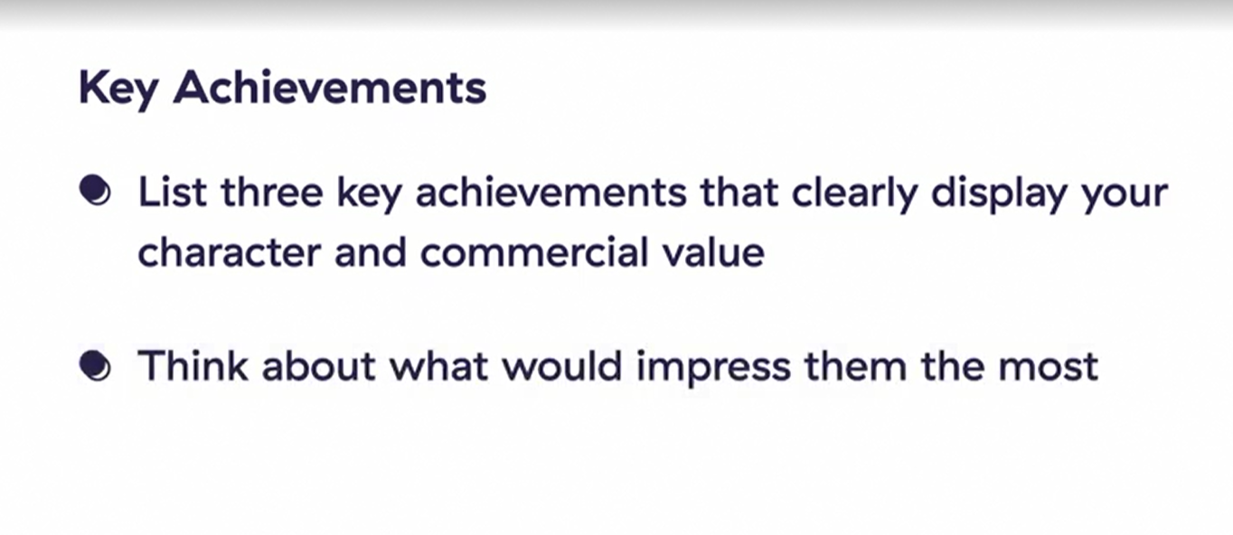

Slide 7
Let’s watch this video and do the Chapter Quiz!
https://www.linkedin.com/learning-login/share?account=76664938&forceAccount=false&redirect=https%3A%2F%2Fwww.linkedin.com%2Flearning%2Fcv-success-master-class%3Ftrk%3Dshare_ent_url%26shareId%3DWnHeQnUMSPOZFPgcY6oozQ%253D%253D

Slide 8
Project Experience
DSGP/ SDGP?
External (If any)

Slide 9
Proof-read your CV Peer- review
https://www.jetbrains.com/shop/eform/students
Spellings- University name
Degree Title

Slide 10
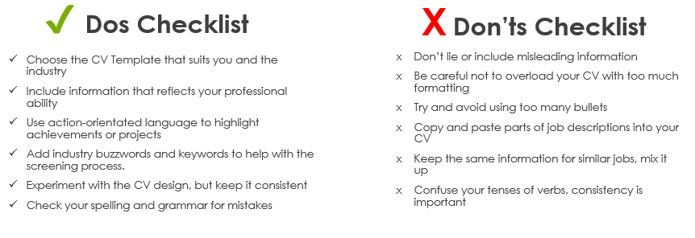

Slide 11
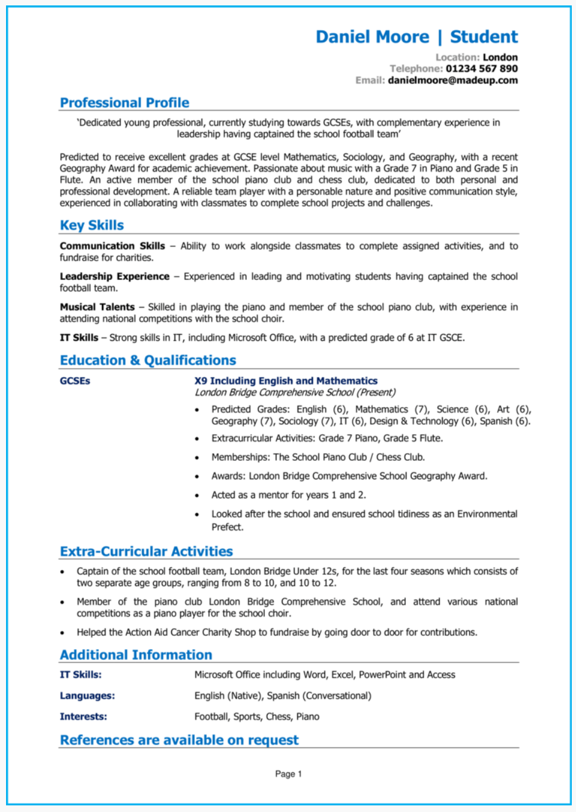
A Good CV... What does it look like?

Slide 12
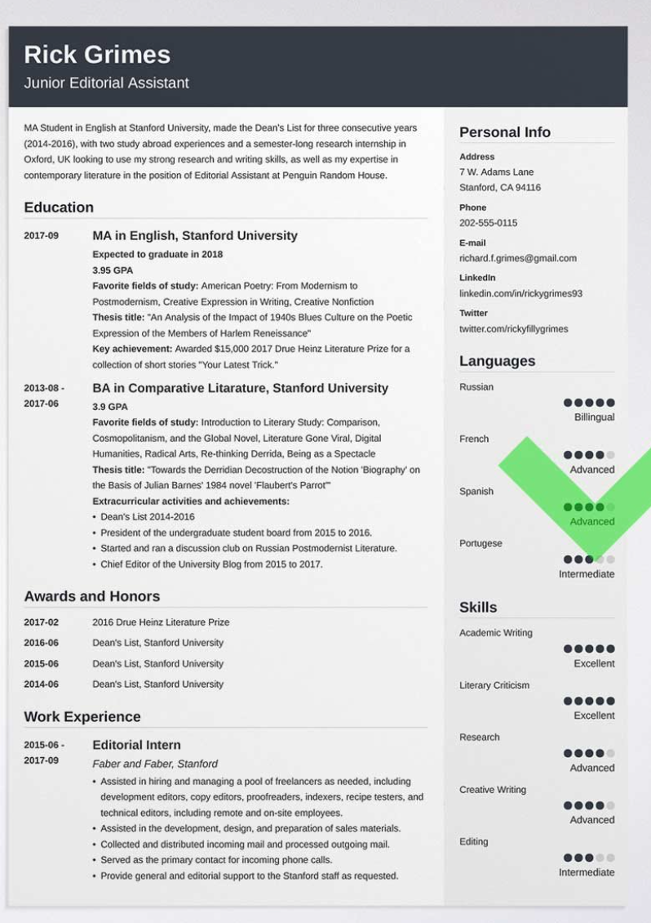
Discussion: What’s wrong with this CV???

Slide 13
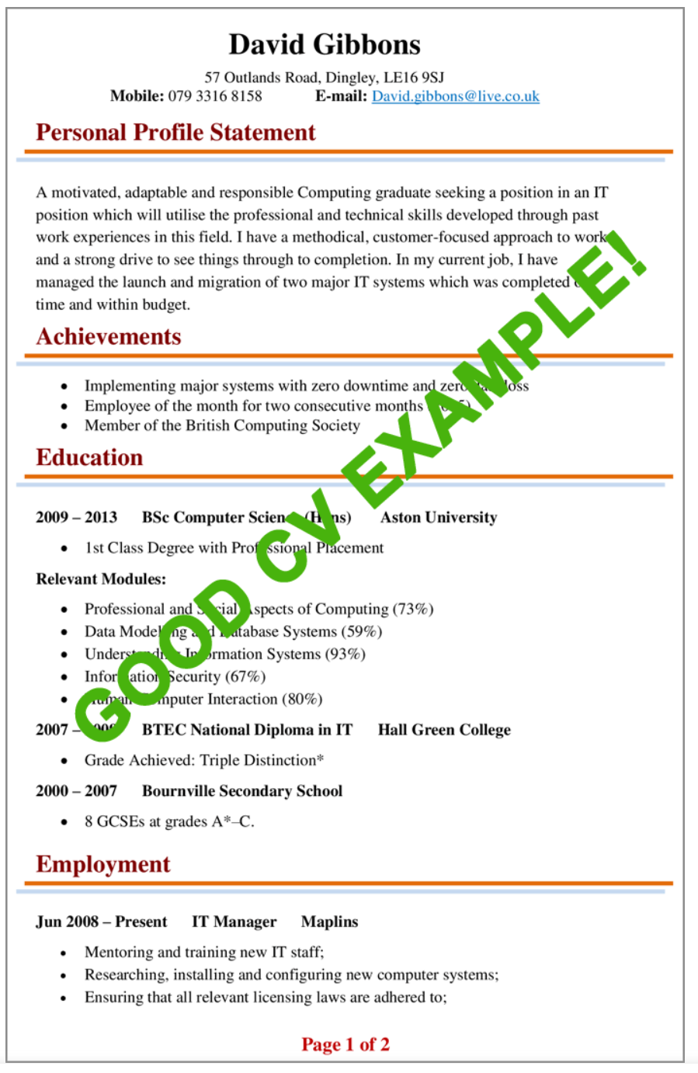

Slide 14
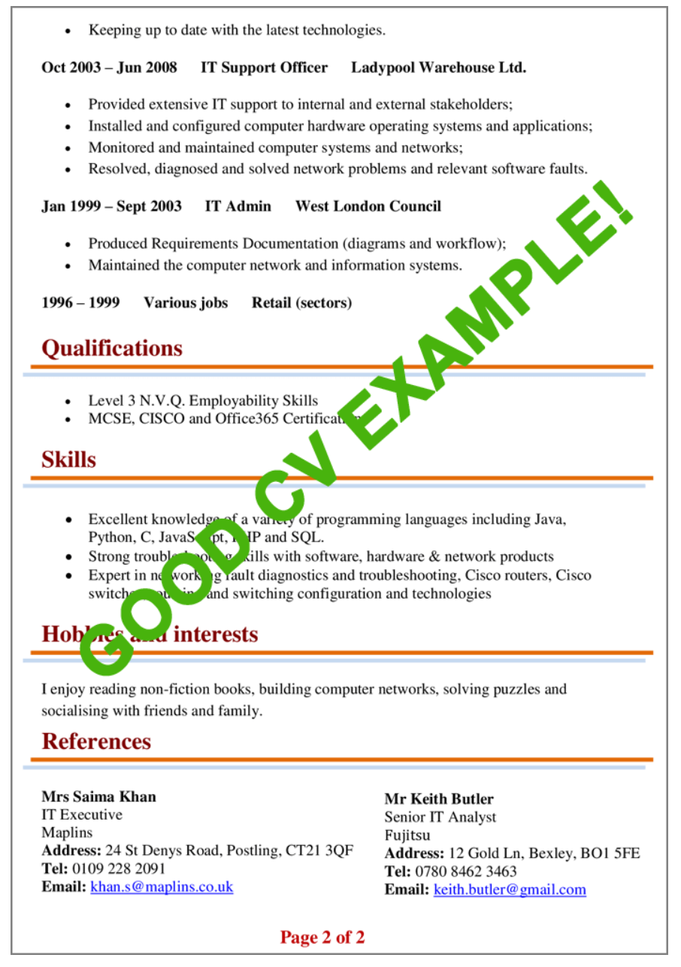

Slide 15
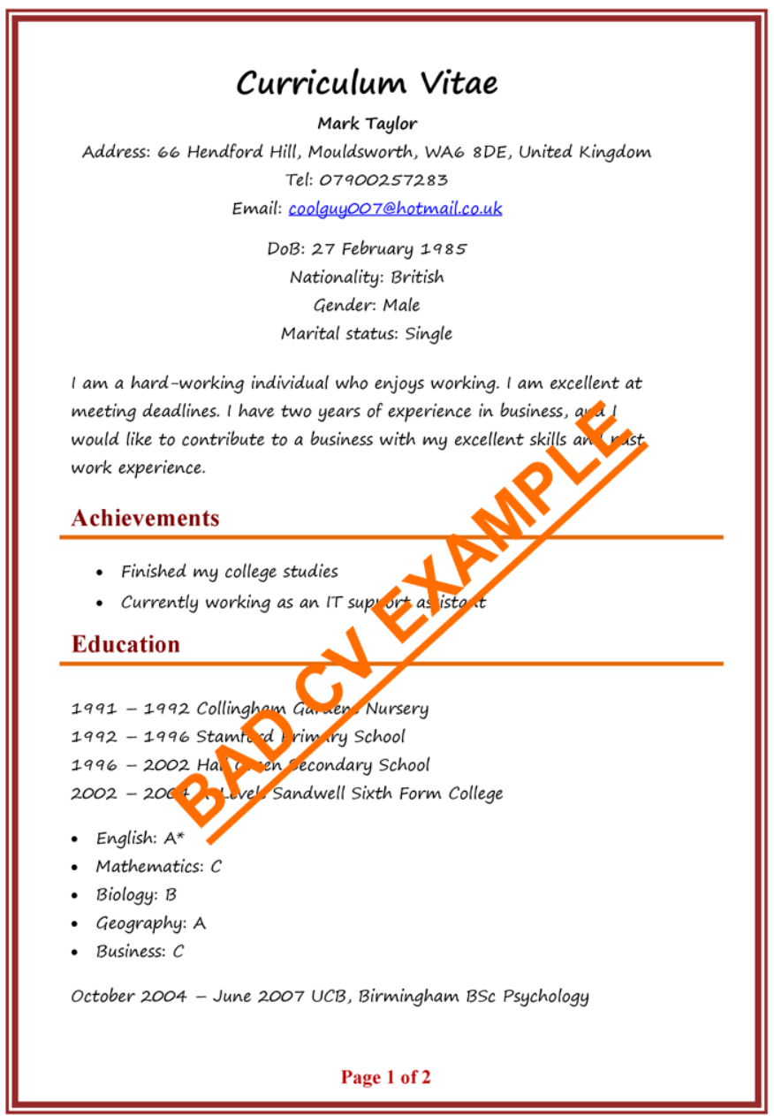

Slide 16
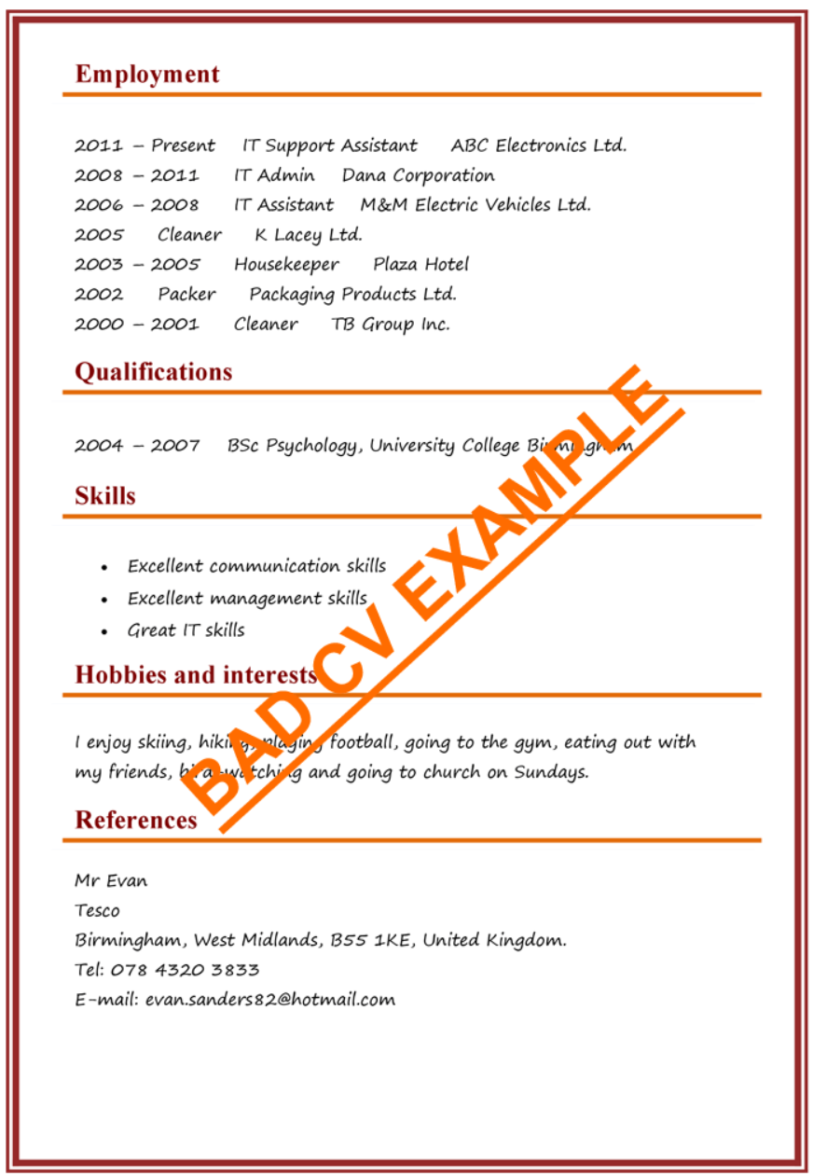

Slide 17
Any Questions?

